Slide 1
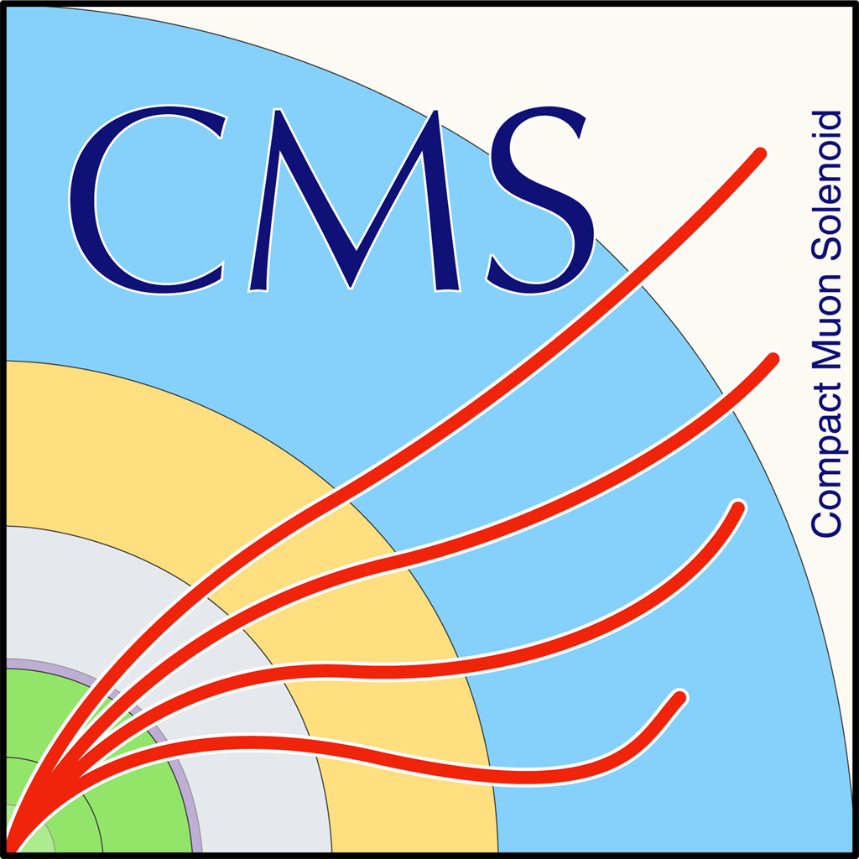

HEP Weekly Report
George Bakas

Slide 2
Weekly Report
Top Tagger:
New WP’s for 2017 and 2018
Closure tests and ttbar CR contamination for 2016, 2017, 2018
Production 2016 data (re-reco)
ArdEnvino
Live measurements at the lab
Sensor is working from early July
DCS:
Alert panel for cooling people: People from cooling section will now have the opportunity to configure the alerts of some of their elements using a panel -> until now they were contacting Central DCS to change alert limits, etc
CMSfwAlertSystem:
changes in how the panel checks whether a system is a production system or not
We found a bug with Anna that leaded to crashing of the main panel→fixed
CMSfwInstallUtils:
ConfDbChecks: This tool helps to check consistency between project and database
Now the user sees all the information regarding the inconsistent elements
Recompile DimBridge with new version of DIM:
DimBridge is a tool that allows the communication between CMS and LHC network
Check that the tool is working
fwInstallationUtils → dbEditorAndNavigator
Several fixes, changes in the already deployed tool

Slide 3
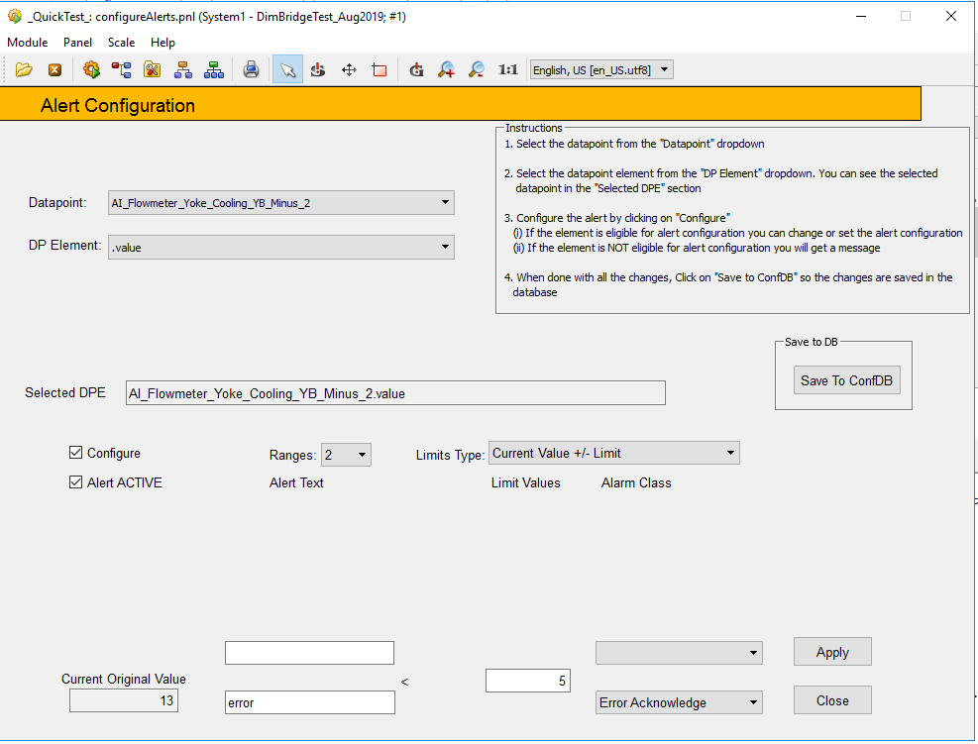
Alert Panel
User selects datapoint and the specified element
Save to DB when finished
Configures the alert (if element is eligigble for alert handling)
Applies Changes

Slide 4
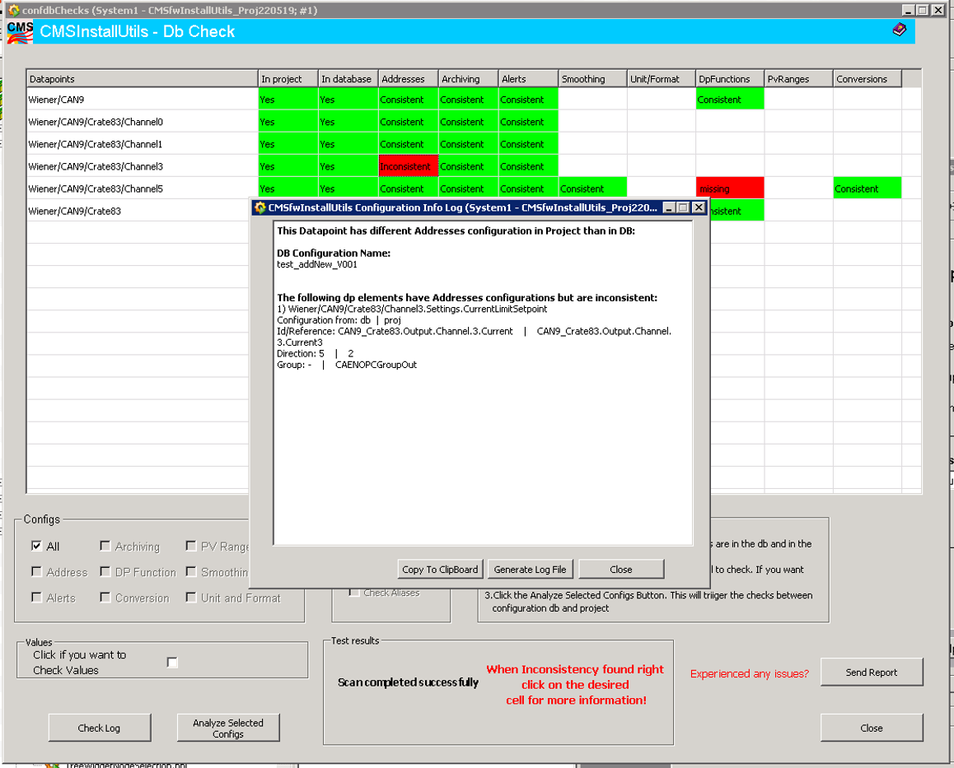
CMSfwInstallUtils
Show the user exactly the reference of the inconsistency

